Slide 1
Video Game Sales and Engagement Analysis

Slide 2
INTRODUCTION
This report analyses the key factors influencing sales trends in the video game industry. It explores various aspects, including the best-selling genres, regions, publishers, platforms performance, Additionally, it examines how backlogs, number of plays, and high ratings impact overall sales performance.
Using Matplotlib, the report visualizes insights from the given dataset, providing a comprehensive view of sales distribution across different regions and a comparison of genre preferences by region. Furthermore, it evaluates the role of genres in shaping sales trends.
Finally, a Power BI dashboard consolidates these findings, offering an overarching view of video game sales and trends

Slide 3
Steps Taken To Analyse The Dataset
Data Cleaning
SQL Database Setup
Power BI Integration
Data Visualization in Power BI
Exploratory Data Analysis (EDA)

Slide 4
Data Cleaning
First, duplicates were removed based on the game's name and release year
Next, null values were replaced using imputation methods. In this case, the mean imputation method was applied to fill missing values in the numeric columns
The column types were adjusted for analytical purposes, including converting the release year column to a date type and changing numeric columns to float to enhance precision in calculations and ensure consistency in data processing.
The Team and Genre columns were standardized into the appropriate format to ensure consistency and accuracy in the analysis.
Replacing shorthand values in numeric columns to ensure consistency and accuracy in calculations

Slide 5
SQL Database Setup
The game and vgsales files, given in CSV format, were first loaded using Pandas. After undergoing data cleaning through various preprocessing techniques, the refined data was stored in MySQL in table format using MySQL Connector.
The tables are systematically structured within the Video Game Sales Analysis database, ensuring optimized organization for efficient querying and insightful analysis.

Slide 6
Power BI Integration
Power BI seamlessly integrates with MySQL to provide an interactive and visually rich analysis of video game sales data. This integration enhances data exploration, trend analysis, and decision-making through dynamic dashboards.
Using Power BI’s MySQL Connector, the cleaned dataset is imported into Power BI. Data transformation techniques, such as filtering, grouping, and creating calculated columns, refine the dataset further. DAX (Data Analysis Expressions) formulas are used to generate insightful metrics like total sales, percentage growth, and regional distribution.

Slide 7
Data Visualization in Power BI
Power BI allows for the creation of interactive dashboards, highlighting key aspects of video game sales:
Sales Trends Visualization
Time-series analysis shows historical sales performance.
Bar charts and line graphs depict sales growth across platforms.
Genre & Regional Comparisons
Bar charts compare the most successful genres worldwide.
Platform & Publisher Analysis
Scatter plots and histograms provide insights into the sales distribution of different platforms.
Pie charts highlight the contribution of leading publishers to overall sales.

Slide 8
Exploratory Data Analysis (EDA)
Exploratory Data Analysis (EDA) is an essential step in understanding and preparing a dataset for further analysis or modeling. It helps identify data quality issues, patterns, trends, correlations, and distributions, ensuring meaningful insights
EDA uncovers hidden patterns, trends, and correlations within the dataset, providing essential business insights.
Analyzing ratings, plays, and wishlists helps understand user behavior and engagement.
Exploring genre and platform popularity provides insights into consumer preferences.
Identifying key success factors for high-selling games helps optimize marketing and development strategies

Slide 9
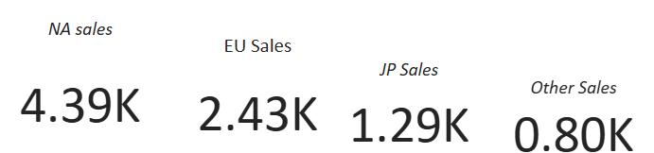
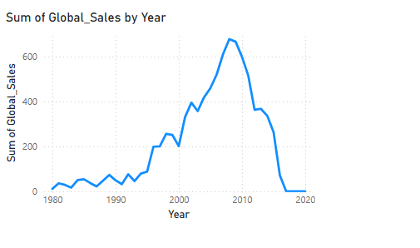
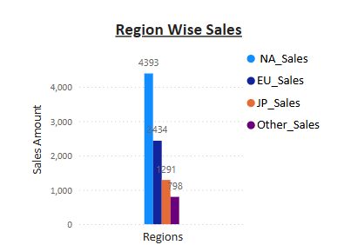
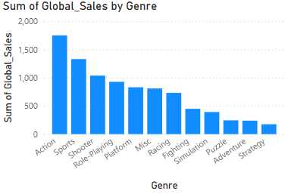
Understanding Sales Trends & Market Dynamics
Yearly sales distribution highlighting 2008 as the peak sales year.
Top-selling region: NA (Followed by EU, JP, and others).
Action genre dominates global sales
Best-performing platforms by region: X360, PS3, PS, DS.

Slide 10
To Improve Sales
Targeted genre expansion
Capitalize on action genre: since action games dominate global sales, publishers can release more high-quality action titles with improved graphics and engaging narratives.
Regional genre preferences: introduce region-specific game genres based on local demand
Platform optimization & expansion
Leverage best-selling platforms: since x360, ps3, ps, and ds perform well, publishers should prioritize releases on these platforms.
Increase platform availability: releasing games on multiple platforms can maximize market reach and drive higher sales.

Slide 11
Regional sales strategies
Boost na market (top-selling region): increase marketing spend and exclusive releases for north america to maintain dominance.
Enhance eu market growth: strengthen european sales by adding localized content, language support, and culturally relevant promotions.
Japan-specific marketing: since sales in japan differ from global trends, customized advertising and partnerships with local distributors could improve reach
Expanding into Emerging Markets
Localizing Content for New Regions: Translate games into multiple languages and adapt them for regional preferences.
Affordable Pricing for Developing Markets: Introduce tiered pricing models to make games accessible in Asia, Latin America, and Africa.
Mobile & Cross-Platform Expansion: Since mobile gaming is growing, porting successful console games to mobile can drive sales.

Slide 12
Future Trends & Strategic Direction
The gaming industry is constantly evolving with advancements in next-generation consoles, cloud gaming, and AI-driven personalization. As technology improves, players expect more immersive experiences, seamless cross-platform access, and personalized recommendations.
To stay competitive, publishers should focus on adapting to regional trends, expanding to multiple platforms, and enhancing consumer engagement through interactive content and live-service models. Additionally, leveraging data-driven insights can help optimize game development, marketing strategies, and pricing models

Slide 13
Thank you

